Slide 1

Department of Information Technology
NBA Accredited A.P. Shah Institute of Technology G.B.Road,Kasarvadavli, Thane(W), Mumbai-400615 UNIVERSITY OF MUMBAI Academic Year 2021-2022

Slide 2
A Project Report on Robotic Process Automation of Supply Chain Management for Healthcare Submitted in partial fulfilment of the degree of Bachelor of Engineering(Sem-8)
in
INFORMATION TECHNOLOGY By Hitarth Saiya(19204007) Jash Seth(19204006) Samyak Doshi(19204001) Under the Guidance of Prof. Vishal Badgujar Prof. Geetanjali Kalme

Slide 3
1.Project Conception and Initiation

Slide 4
1.1 Abstract
Need for systematic deliverance of the healthcare sector is in demand.
Delay in restocking of medicines affects the healthcare profitability.
RPA can create, deploy and manage bots to automate certain human actions.
Paper describes how RPA can automate various processes of SCM Healthcare.

Slide 5
1.2 Objectives
To automate inventory management System.
To maintain the adequate stocks of medications.
To minimize the occurrence of unexpected out-of-stock scenarios resulting from depletion or expiration of inventory.
To automate vendor selection Process.
To automate vendor On Boarding Process.

Slide 6
1.3. Literature Review
Sr.No. | Authors | Title | Methodologies | Findings
1 | Allam Maalla | Development Prospect and Application Feasibility Analysis of Robotic Process Automation | Study the enterprise problems that RPA can solve, Feasibility analysis of RPA application. | With the development of artificial intelligence, the combination of artificial intelligence technology with automation technology will make RPA more competitive.
2 | Yatskiv, S., Voytyuk, I., Yatskiv, N., Kushnir, O., Trufanova, Y., & Panasyuk, V. | Improved Method of Software Automation Testing Based on the Robotic Process Automation Technology | Compared two main approaches i.e. Selenium Web Driver & WorkFusion, to the test automation. | The most effective RPA automation is when user interacts with different applications and needs to have specific actions done before test execution.

Slide 7
1.4 Problem Definition
Problem Identified
Existing SCM of Healthcare relies on a group of people.
No clear idea for the entire process journey.
Process of Vendor selection and Vendor onboarding are handled manually.
Order Processing and Inventory management are handled manually.
Time consuming and more prone to human errors.
Proposed Solution
Software bots programmed to automate all the processes of SCM healthcare.

Slide 8
1.5 Scope
Using autonomous bots we can finalize the vendor selection and vendor onboarding in accordance with predefined criteria.
We can automate the order processing task to reduce the workload of manual process.
We can automate the inventory management so that bot can notify when stock level are low, also reorder the products that go below a threshold level, etc.

Slide 9
1.6 Technology stack
Back End:-
RPA Tool (Blue Prism)
SQL Express
C#
Front End:-
Sigma

Slide 10
1.7 Benefits for environment & Society
The automation minimizes the time, effort, waste and labor cost and maximize s the productivity and financial improvements.
It will help to ensure medications are available whenever the patients need them.
It will help to finalize the vendor as soon as the tenure for current vendor terminates.

Slide 11
2. Project Design

Slide 12
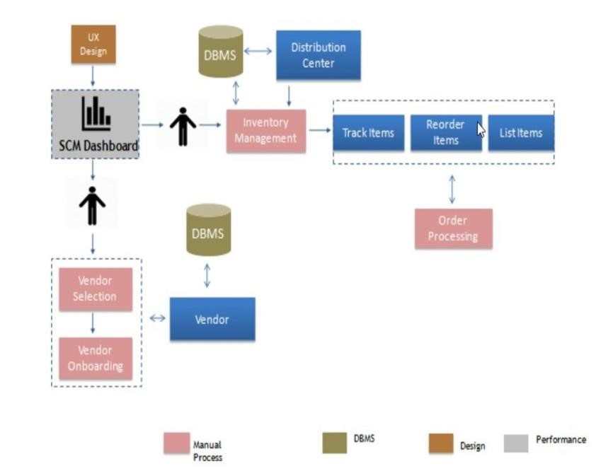
2.1 Existing System

Slide 13
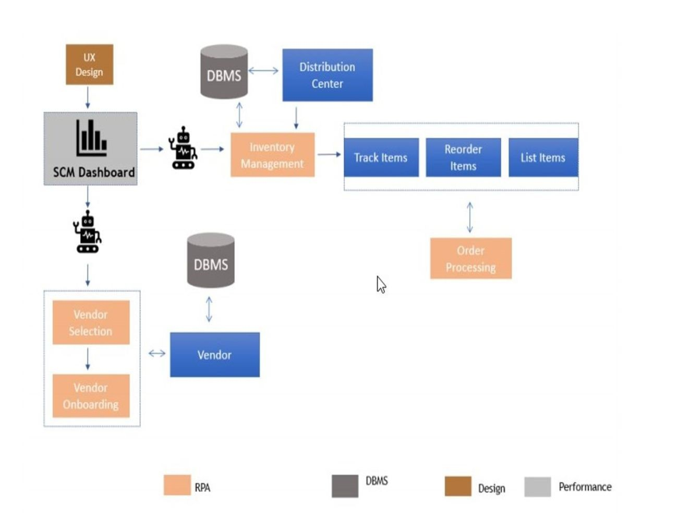
2.2 Proposed System

Slide 14
2.3 Design(Flow Of Modules)
https://lucid.app/lucidchart/invitations/accept/inv_7d8e1ff2-74bd-4f0b-a543-a59a81842f9f?viewport_loc=-1341%2C79%2C4377%2C1696%2C0_0

Slide 15
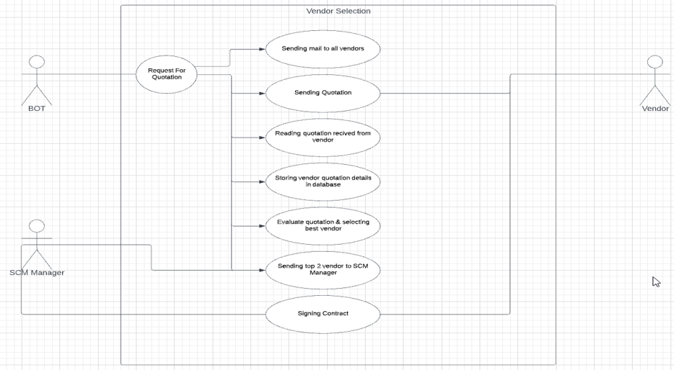
2.4 Description Of Use Case (Vendor Selection)

Slide 16
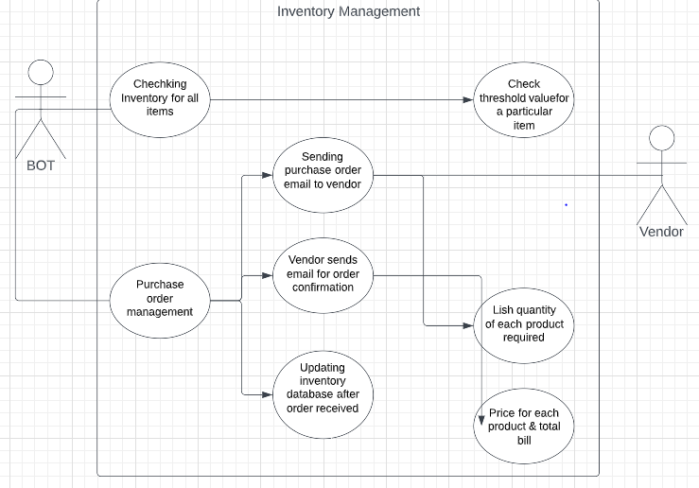
2.4 Description Of Use Case (Inventory Management)

Slide 17
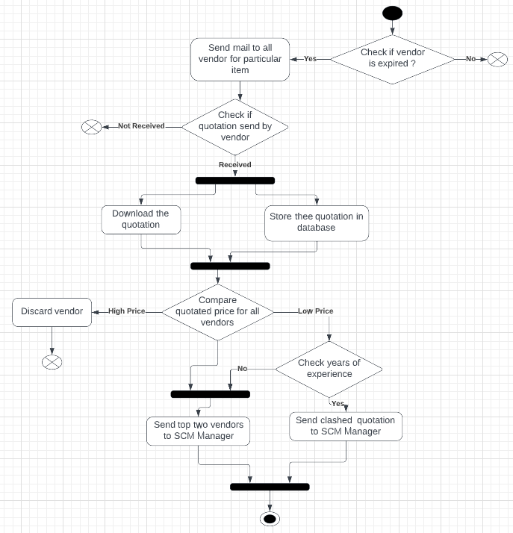
2.5 Activity diagram (Vendor Selection)

Slide 18
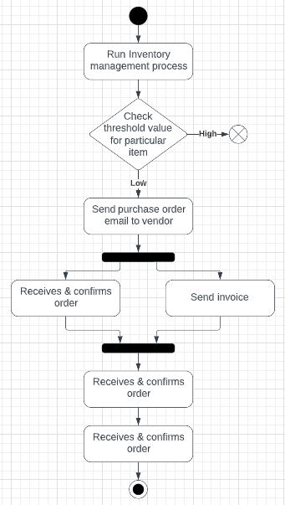
2.5 Activity Diagram (Inventory Management)

Slide 19
3. Implementation

Slide 20
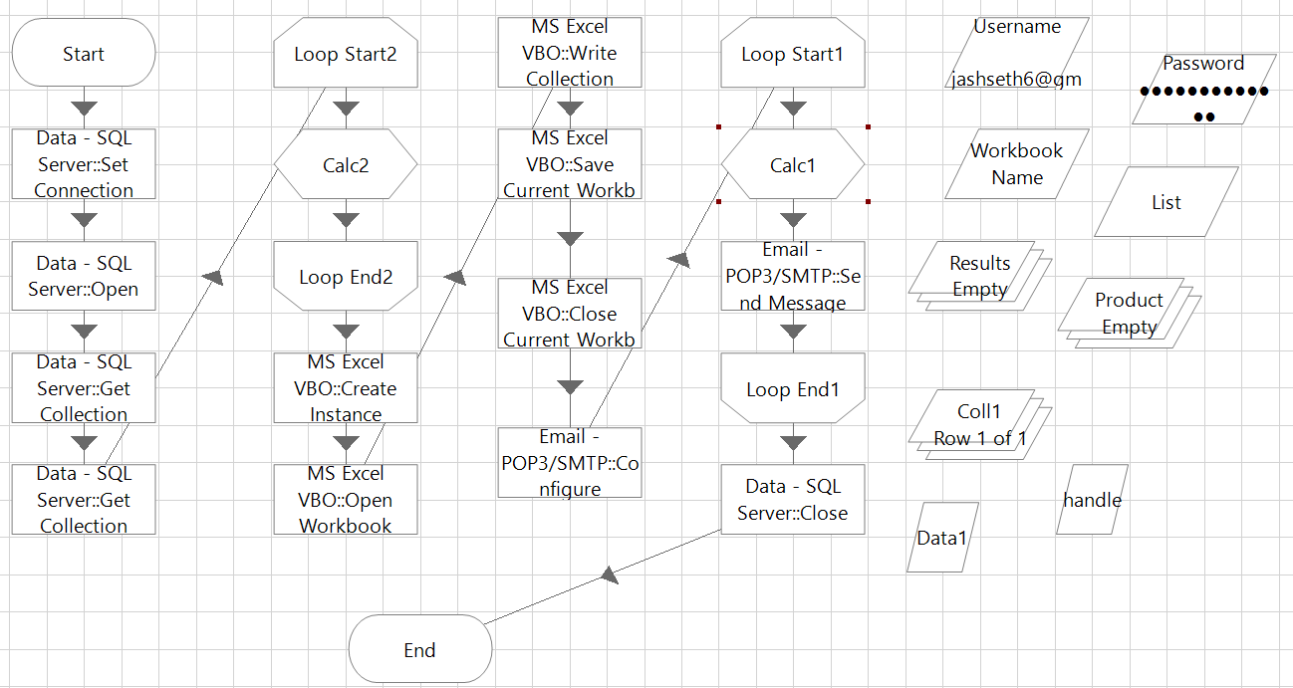
3.1 Sending quotation format to all vendors (Vendor Onboarding)

Slide 21
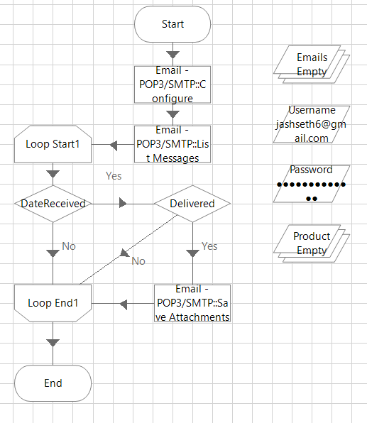
3.2 Reading all 30 days emails with subject “Sending Quotation”

Slide 22
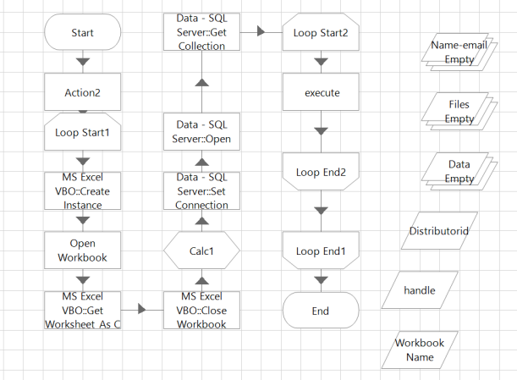
3.3 Reading and storing quotations

Slide 23
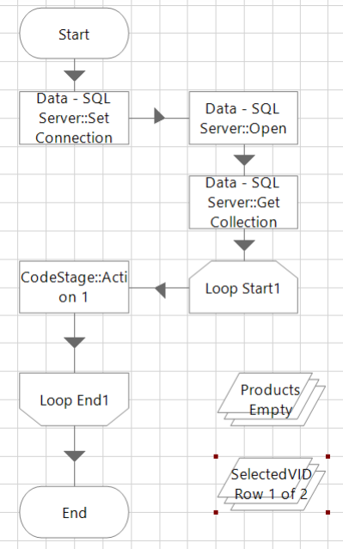
3.4 Vendor Selection

Slide 24
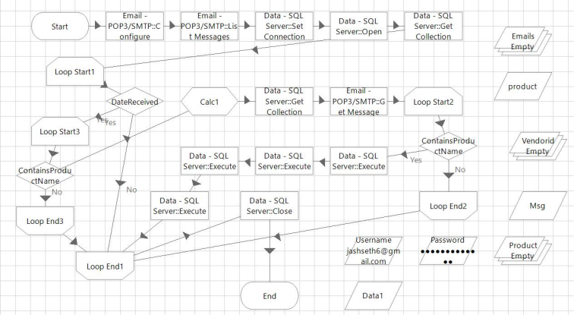
3.5 Updating Database when Vendor Selected

Slide 25
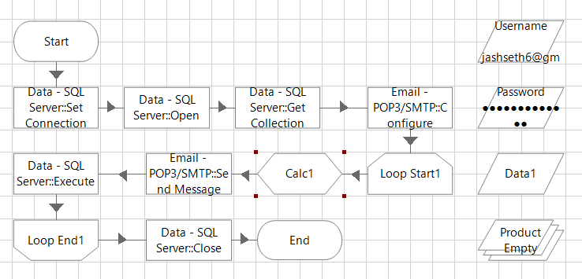
3.6 Check inventory and send mail to vendor to order required medicine.

Slide 26
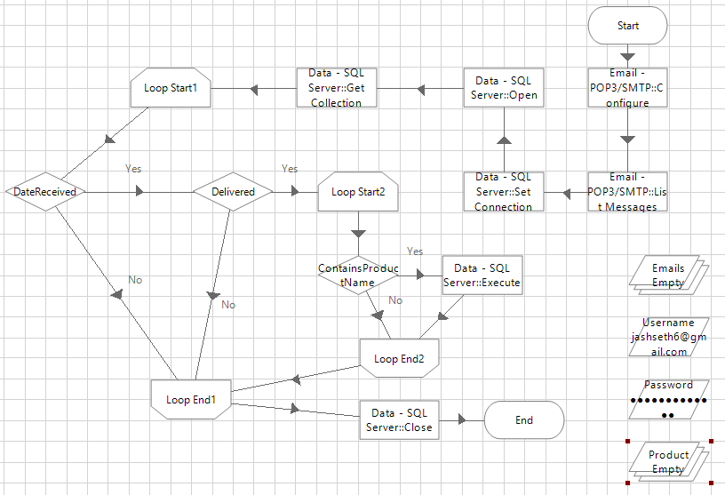
3.7 Updating Inventory when Product Delivered

Slide 27
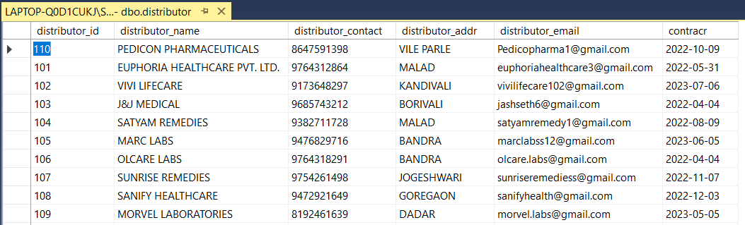
3.8 Table of vendors

Slide 28
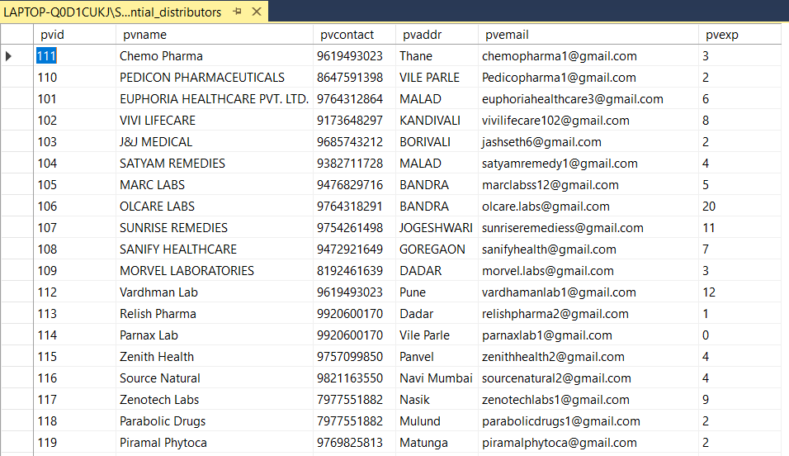
3.9 Table of potential vendors

Slide 29
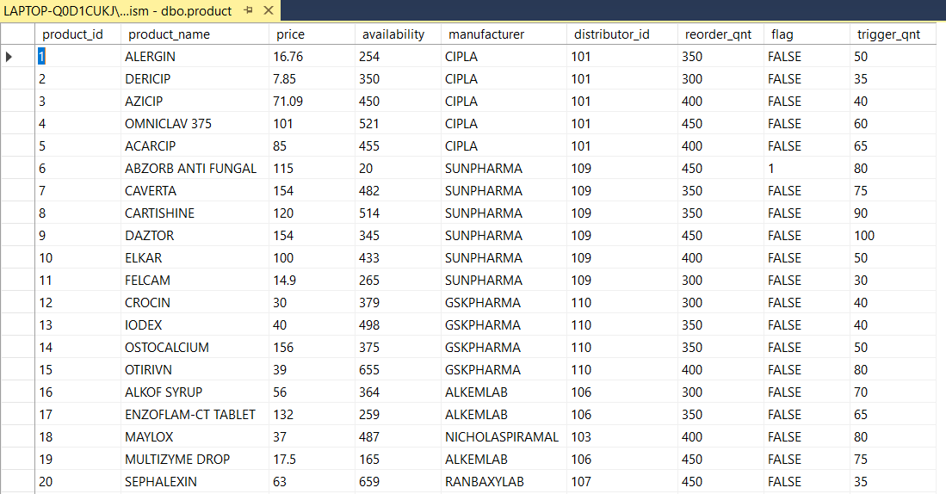
3.10 Table of products

Slide 30
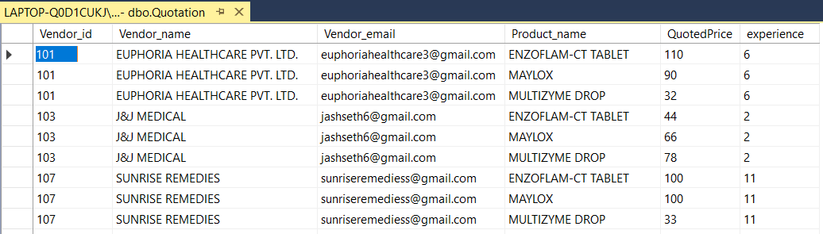
3.11 Table of quotations

Slide 31
4. Testing

Slide 32
4.1 Functional Testing
A. Unit Testing
Unit testing is the testing of an individual unit of a software at the code level are functional and work as they were designed.
Testing of each process separately, like the vendor selection, vendor onboarding, order processing and inventory management.
All these processes are tested and debugged before going for further integration.
And check whether we are getting the desired output from each process as for the objectives.

Slide 33
4.1 Functional Testing
B. Integration Testing
After each unit is thoroughly tested, it is integrated with other processes to create modules or components that are designed to perform specific tasks or activities.
These are then tested as group through integration testing to ensure whole segments of an application behave as expected.

Slide 34
4.2 Non-Functional Testing
A. Usability Testing
Usability testing is a testing method that measures an application’s ease of use from the end-user perspective and is often performed during the system or acceptance testing stages.
Usability testing is a great way for teams to review separate functions, or the system as a whole is intuitive to use.

Slide 35
5. Results

Slide 36
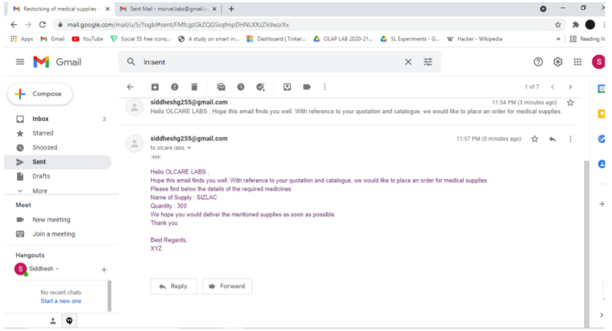
5.1 Placing Order to Vendor

Slide 37
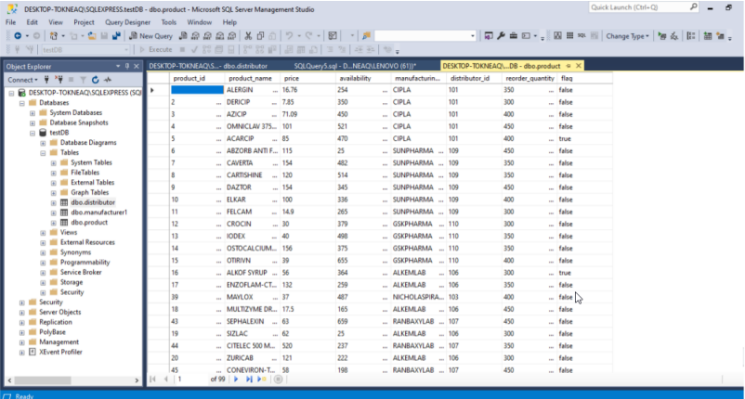
5.2 Updating the quantity in database

Slide 38
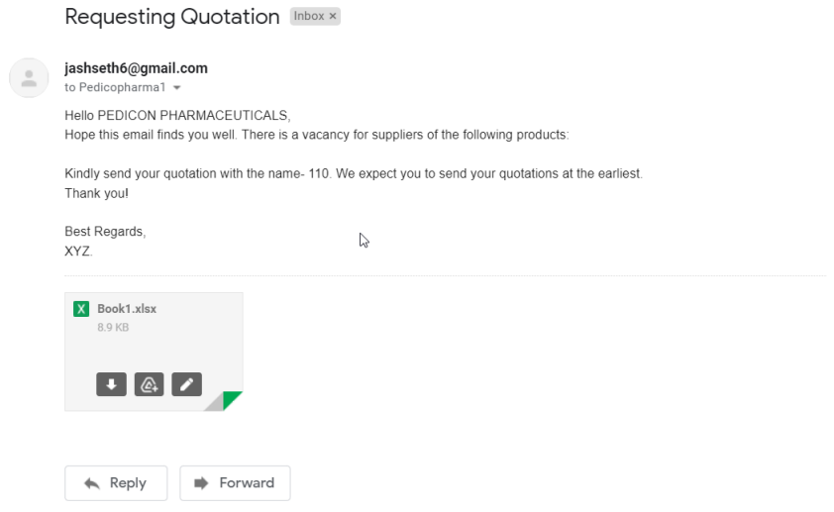
5.3 Requesting Vendors to send quotation

Slide 39
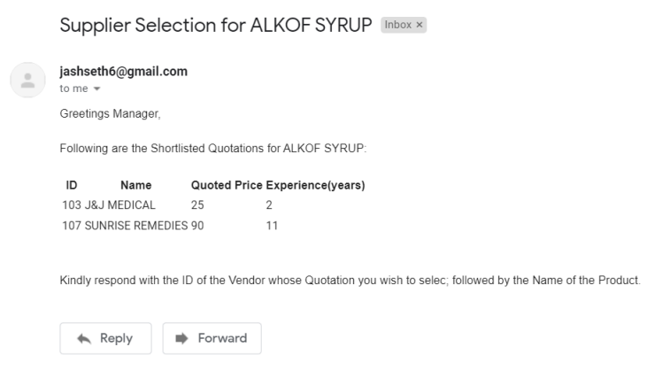
5.4 Send best 2 quotation to SCM Manager

Slide 40
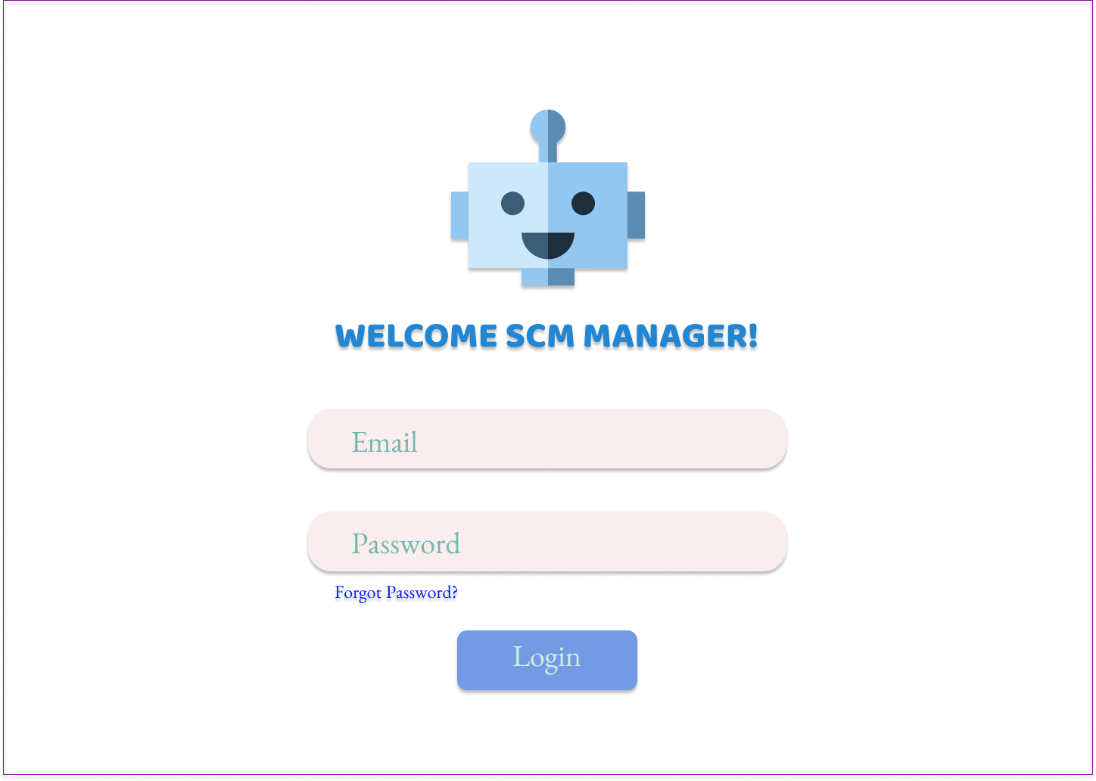
5.5 SCM Manager Login

Slide 41
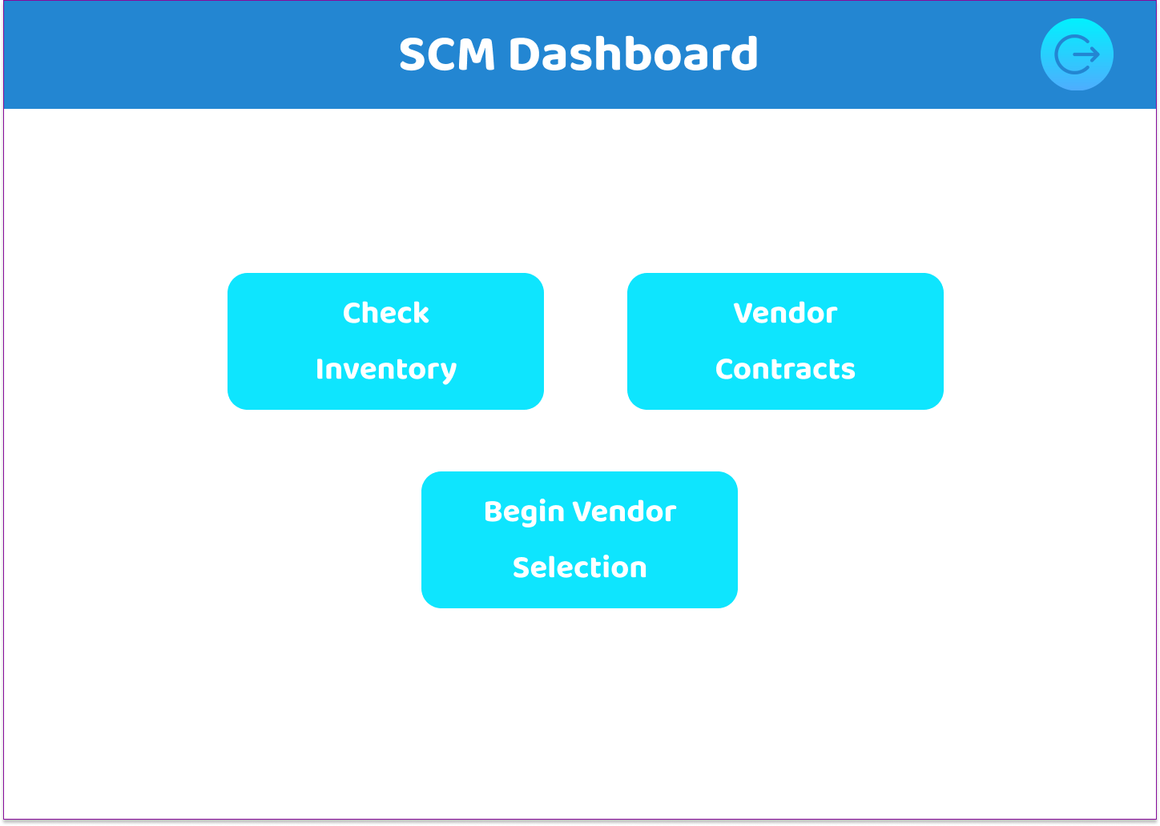
5.6 SCM Manager Dashboard

Slide 42
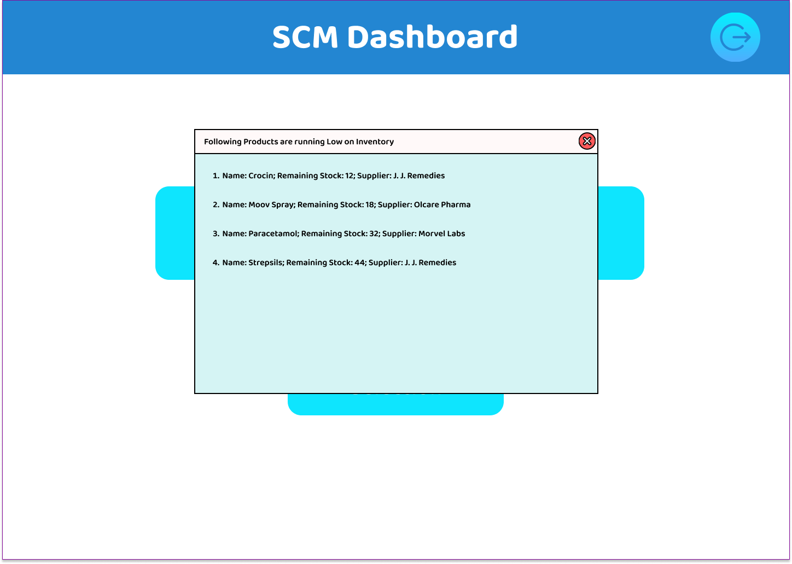
5.7 Check Inventory

Slide 43
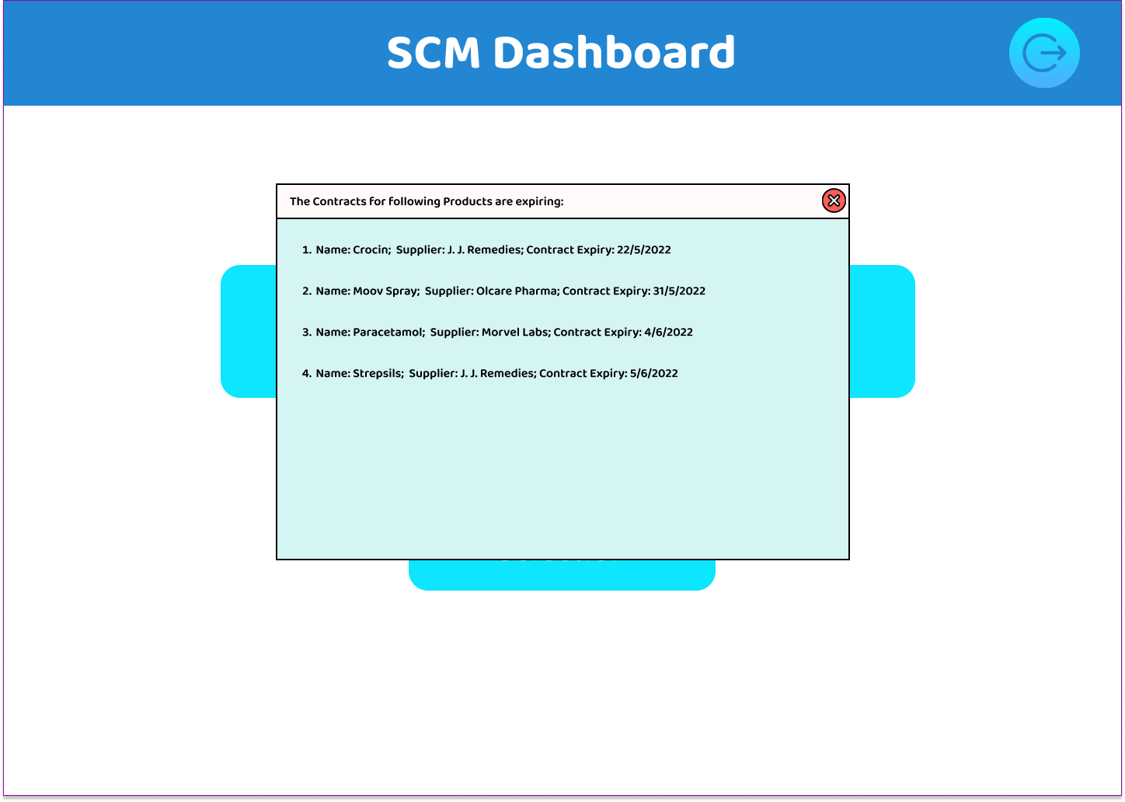
5.8 Vendor Contracts

Slide 44
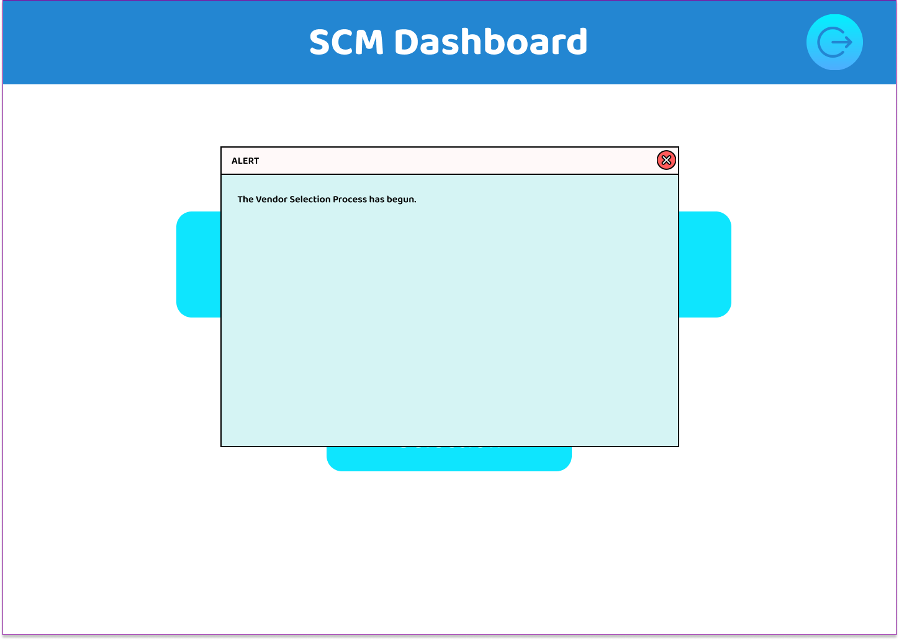
5.9 Begin Vendor Selection

Slide 45
6. Conclusion and Future Scope

Slide 46
6.1Conclusion
Existing SCM of healthcare has disadvantages because of human management of processes.
The proposed system overcome the several shortcomings in SCM such as:
Frequent human errors
Excess delay
Inaccuracies, etc.
Automated the key processes such as:
Vendor Selection
Vendor Onboarding
Order Processing
Inventory Management

Slide 47
6.2 Future Scope
To integrate SCM Manager dashboard to BluePrism software.
To use data analysis and set the threshold value of a product based on its demand.

Slide 48
References
A. Maalla, "Development Prospect and Application Feasibility Analysis of Robotic Process Automation," 2019 IEEE 4th Advanced Information Technology, Electronic and Automation Control Conference (IAEAC), 2019.
S. Yatskiv, I. Voytyuk, N. Yatskiv, O. Kushnir, Y. Trufanova and V. Panasyuk, "Improved Method of Software Automation Testing Based on the Robotic Process Automation Technology," 2019 9th International Conference on Advanced Computer Information Technologies (ACIT), 2019.
S. Voeng and D. Kritchanchai, "Factors Influencing Supplier Selection for Vendor Managed Inventory Adoption in Hospitals," 2019 4th Technology Innovation Management and Engineering Science International Conference (TIMES-iCON), 2019.

Slide 49
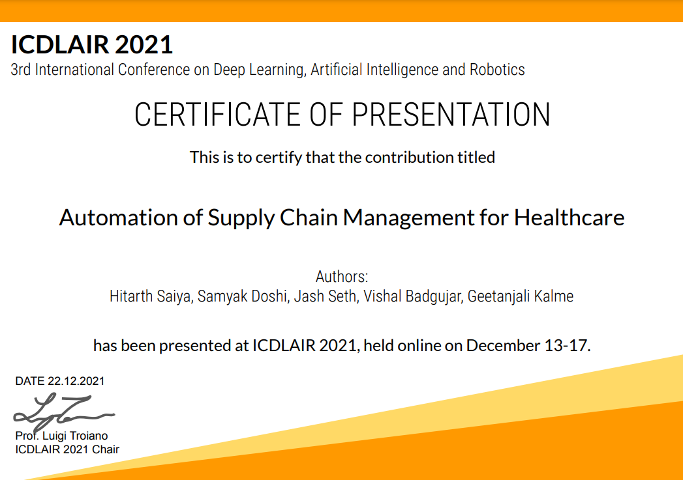
Paper Publication

Slide 50
Thank You

